Slide 1


Slide 2
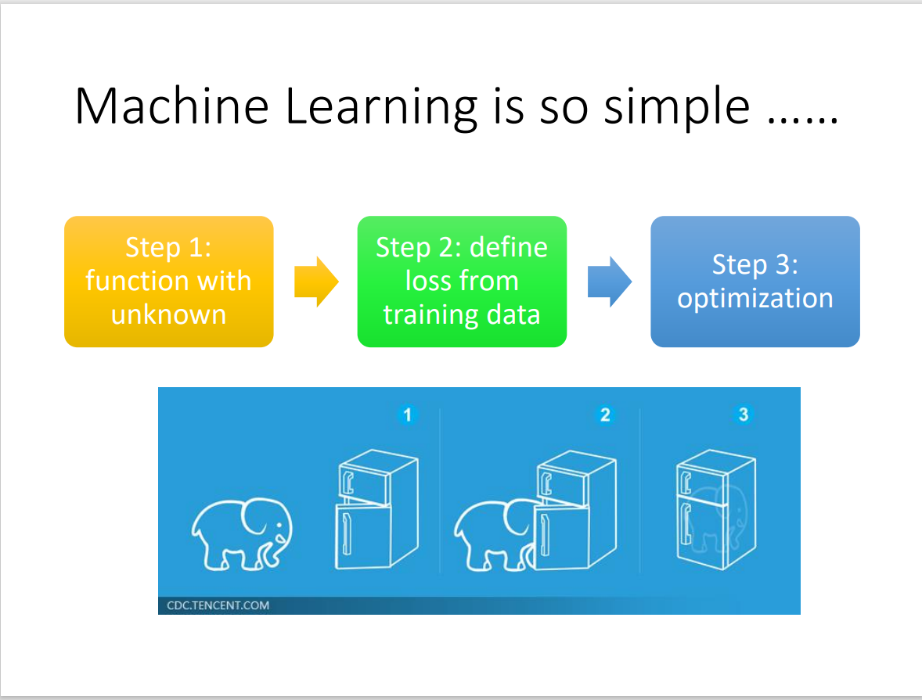

Slide 3
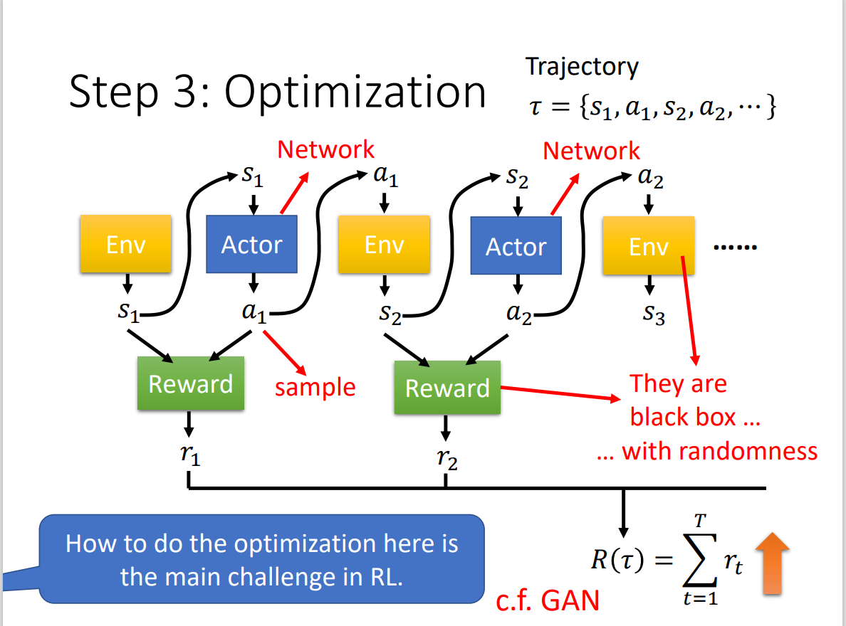

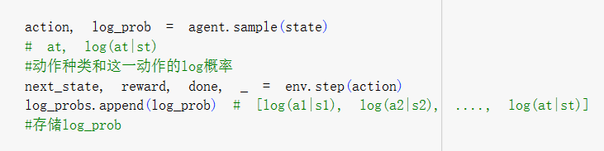
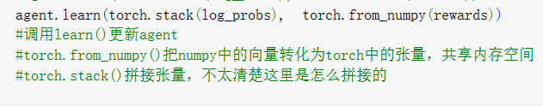
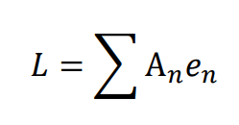

一个episode
一个batch

Slide 4
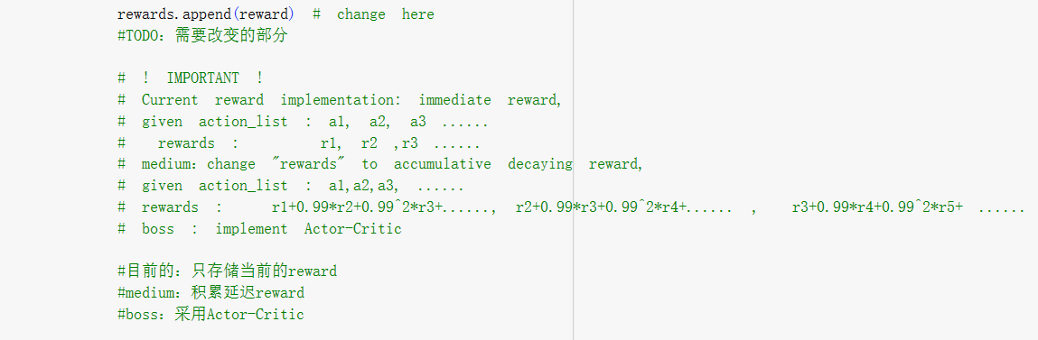
Simple: reward直接相加
Medium：accumulative decaying reward
Strong： 采用Actor-Critic
Boss: Advantage Actor-Critic
改变A

Slide 5
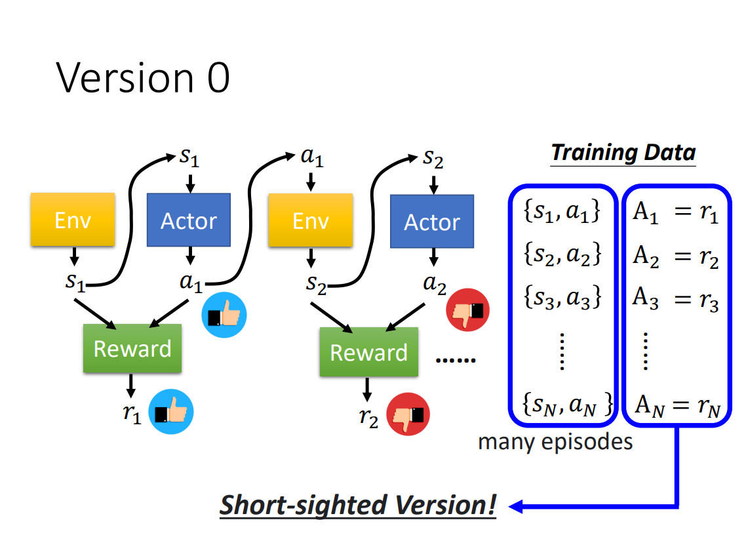
Simple
Your final reward is : -99.42

Slide 6
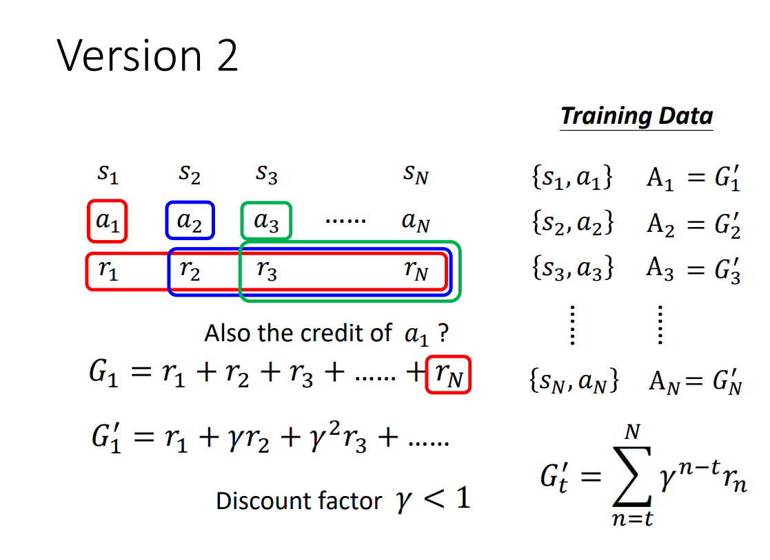
Medium
Your final reward is : 46.57

Slide 7
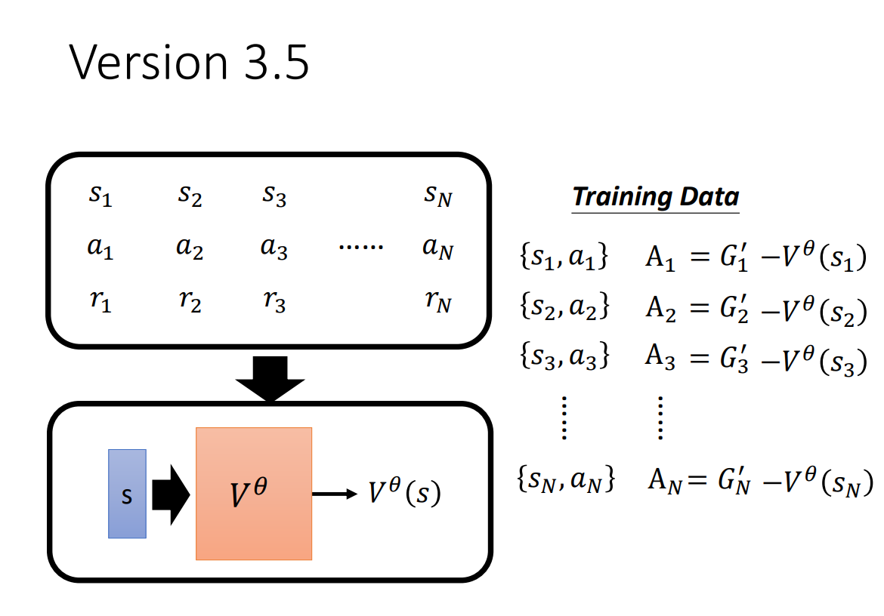
Strong
Your final reward is : 82.13

Slide 8
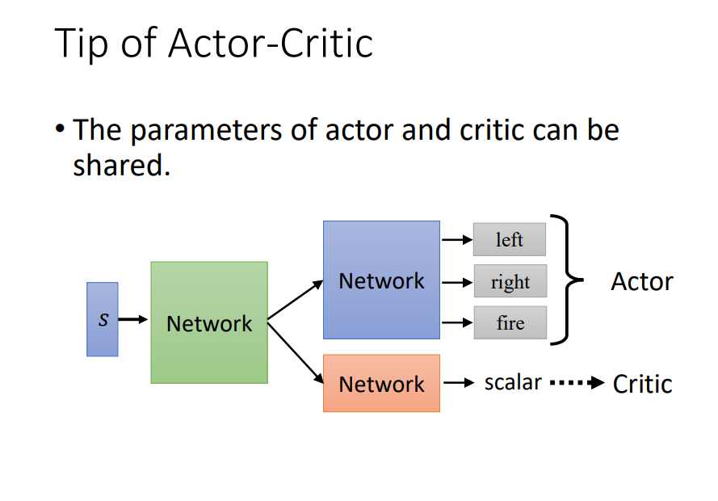
问题：如何训练

Slide 9
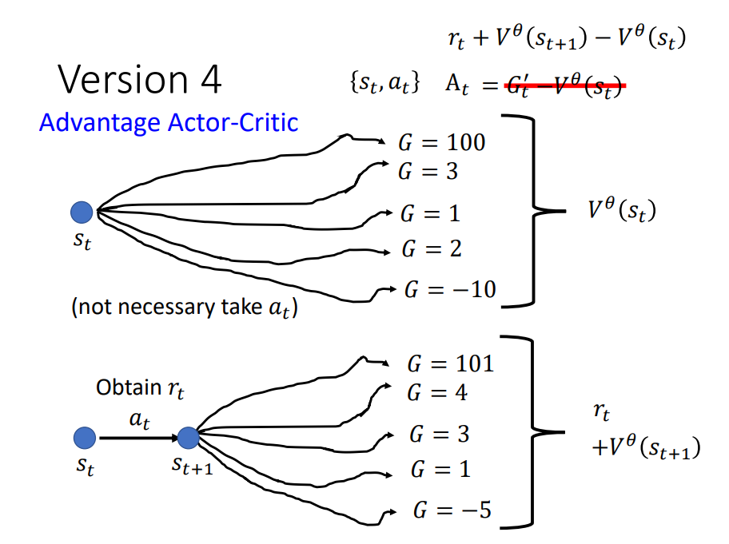
Boss
Your final reward is : 146.05

